Slide 1


Chunked, Compressed, & Cloud-native N-dimensional arrays
Exploring Zarr: From Fundamentals to V3.0 & Beyond

Slide 2


Sanket Verma
@MSanKeys963
Community and OSS @ Zarr

Slide 3

Slides
https://bit.ly/explore_zarr_v3

Slide 4

Slides & Notebook
https://bit.ly/explore_v3_more

Slide 5
What I’ll be talking about?
→ What is Zarr?
→ What’s new in the Zarr Spec V3?
→ What is the Zarr Community and ZEPs?
→ Demo

Slide 6
How Zarr works?

Slide 7
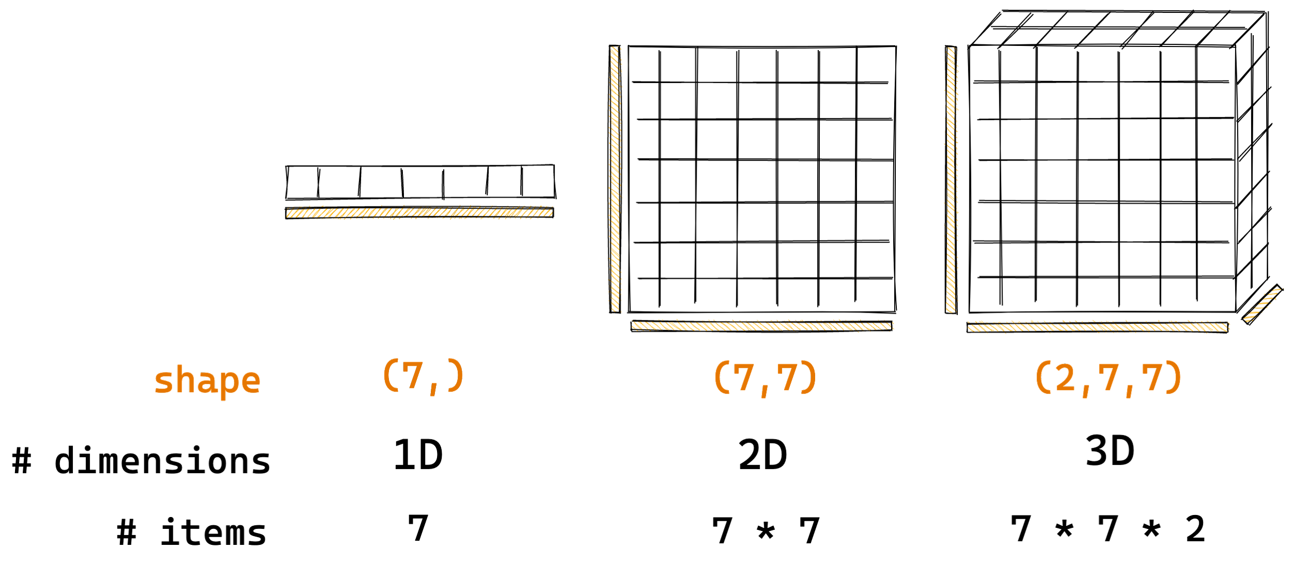
How Zarr works?
Arrays are container of items of the same data-type & size (in bits). The number of dimensions and items in container are described by the shape.
Credit: @trevmanz

Slide 8

How Zarr works?
Credit: @trevmanz

Slide 9
How Zarr works?
What if the data is too big to fit in memory?
Credit: @trevmanz

Slide 10
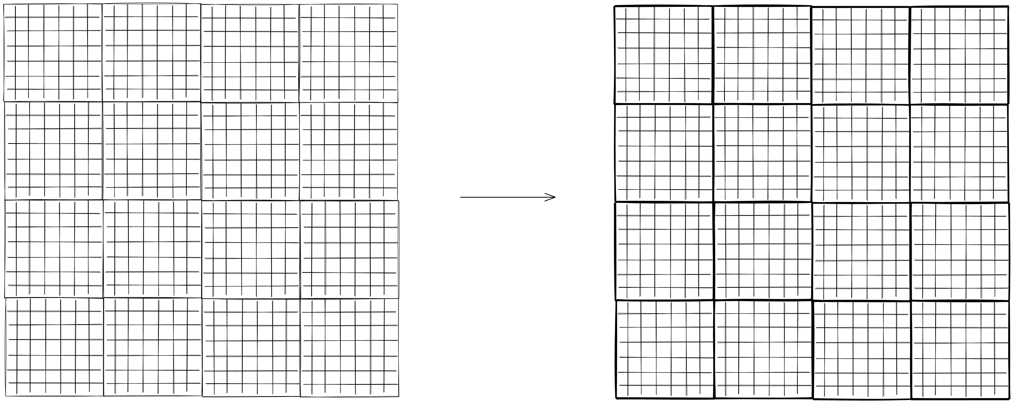
How Zarr works?
Divide array into chunks (Chunking)
Credit: @trevmanz

Slide 11
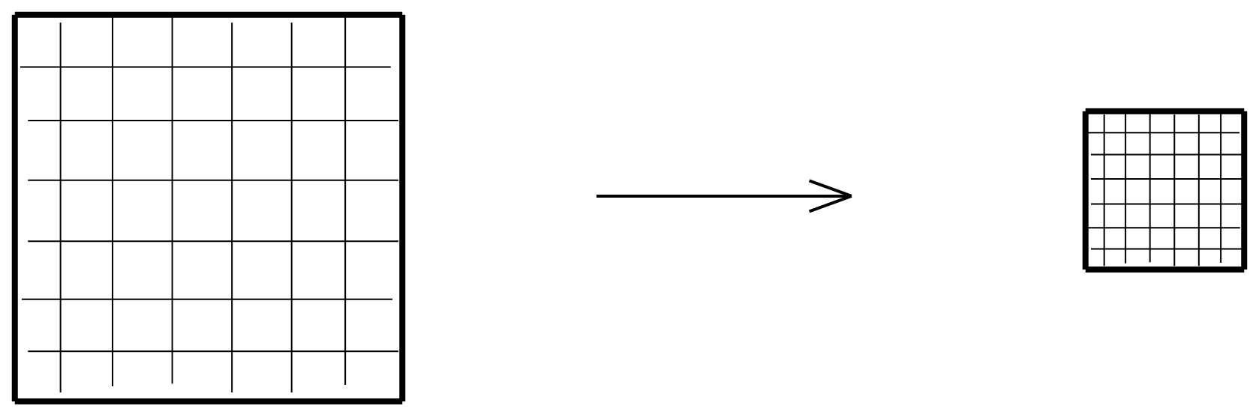
How Zarr works?
Compress each chunk
Over 20 supported compressors (BLOSC, Zstd, Zlib etc)
Credit: @trevmanz

Slide 12
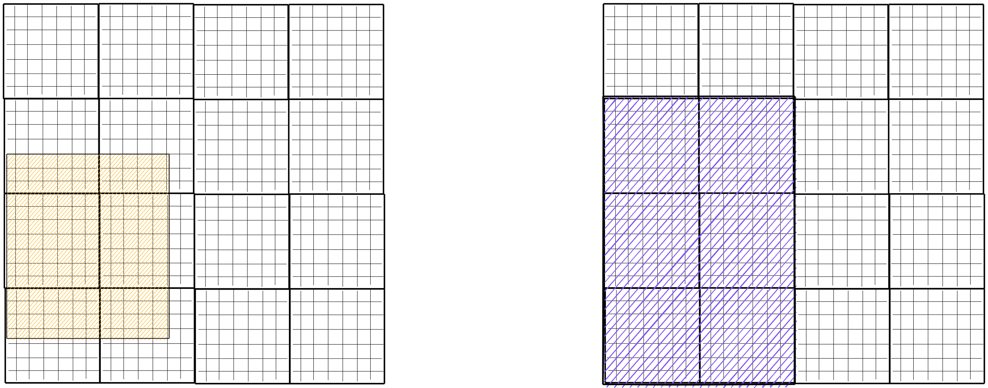
How Zarr works?
Retrieve chunks only when needed
Credit: @trevmanz

Slide 13
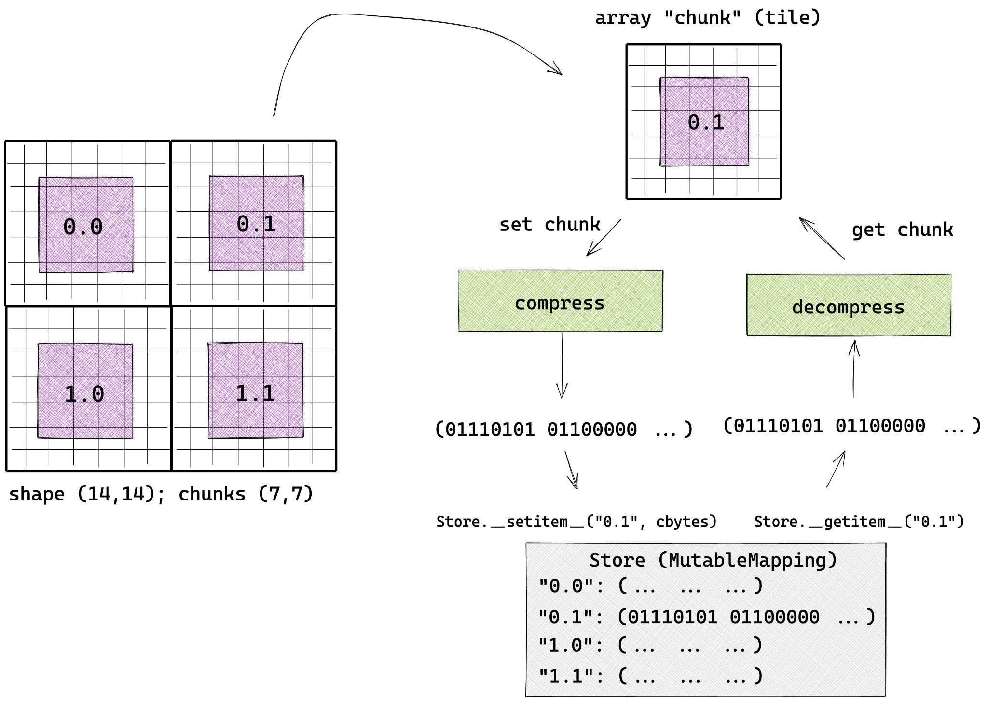
How Zarr works?
Credit: @trevmanz

Slide 14
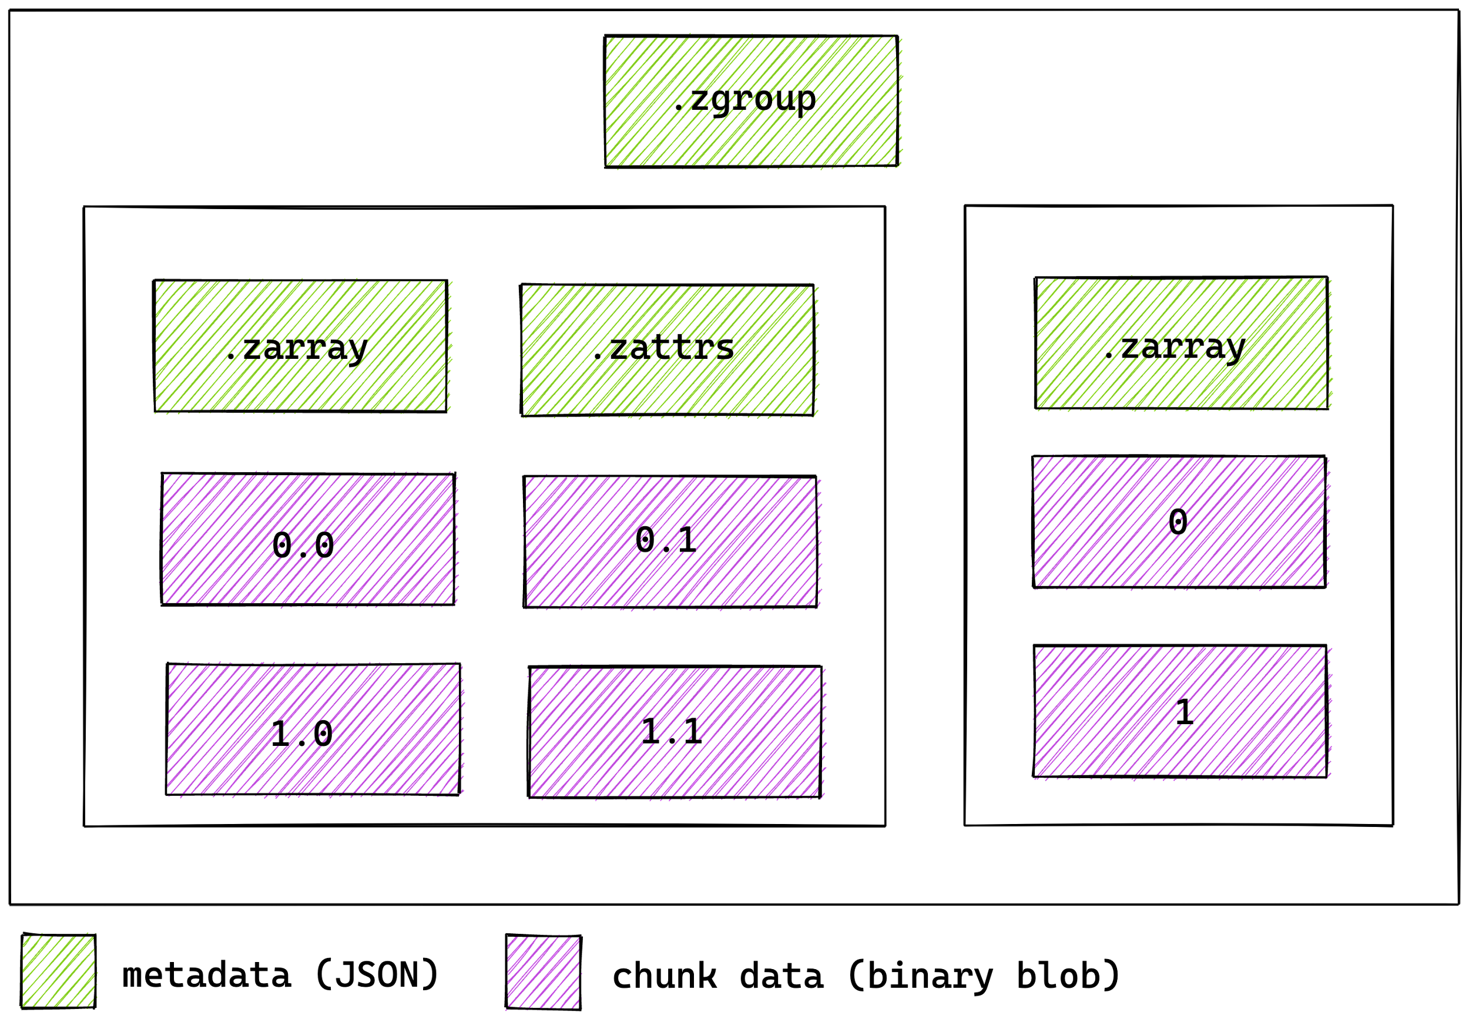
How Zarr works?
Multiple arrays can be organised in hierarchies of groups
Credit: @trevmanz

Slide 15

Zarr Specification
V1 → V2 → V3
https://zarr-specs.readthedocs.io/

Slide 16
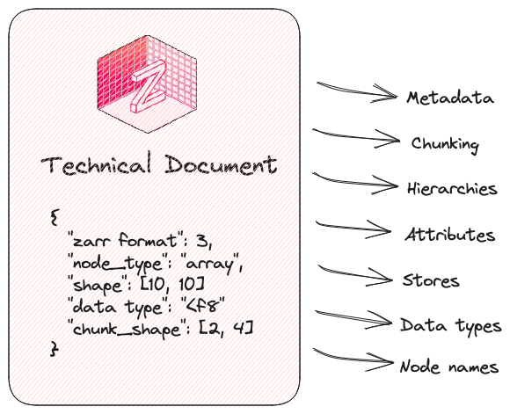
Zarr Specification

Slide 17







↔

Slide 18
Why did we work on V3 Specification?

Slide 19
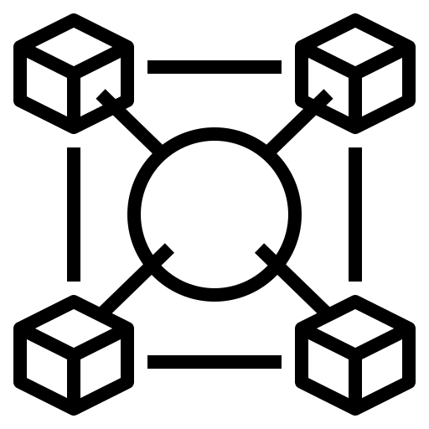


The Motivation
Interoperability High-latency storage
Extensibility
Notes:
Simple. → Spec.

Slide 20
Major design updates

Slide 21
Restructured the JSON metadata

Slide 22
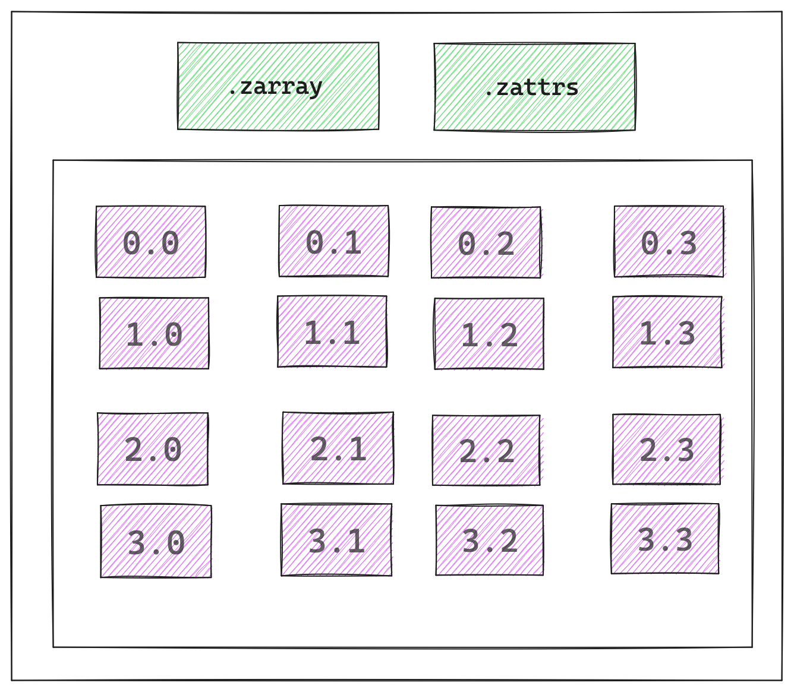
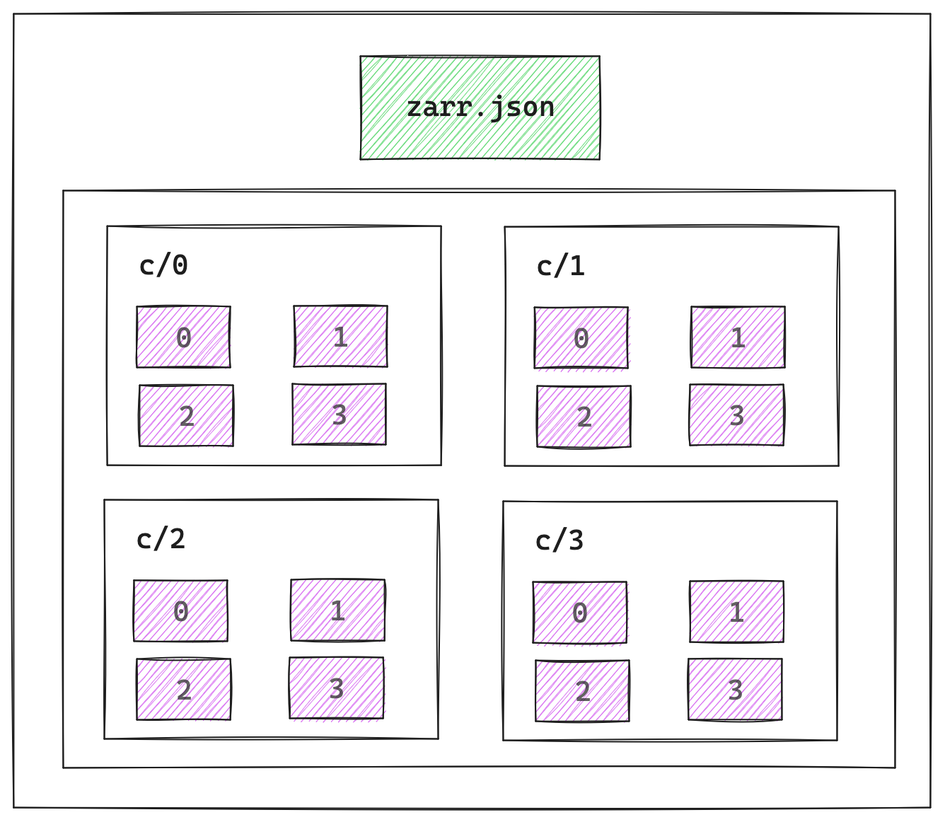
Zarr Arrays → V2 vs. V3
V2
V3

Slide 23
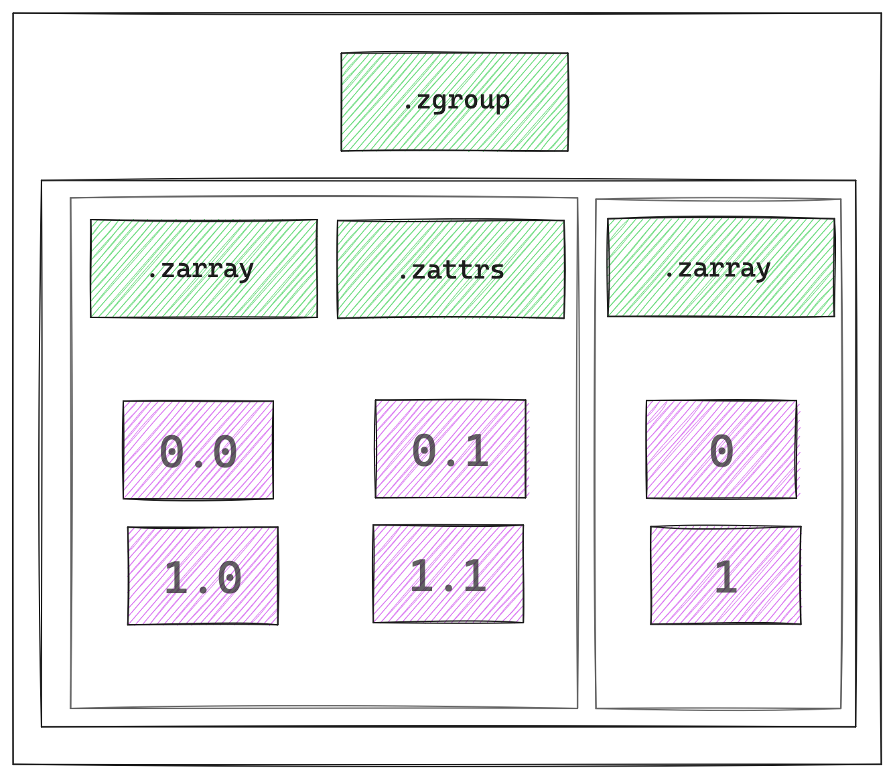
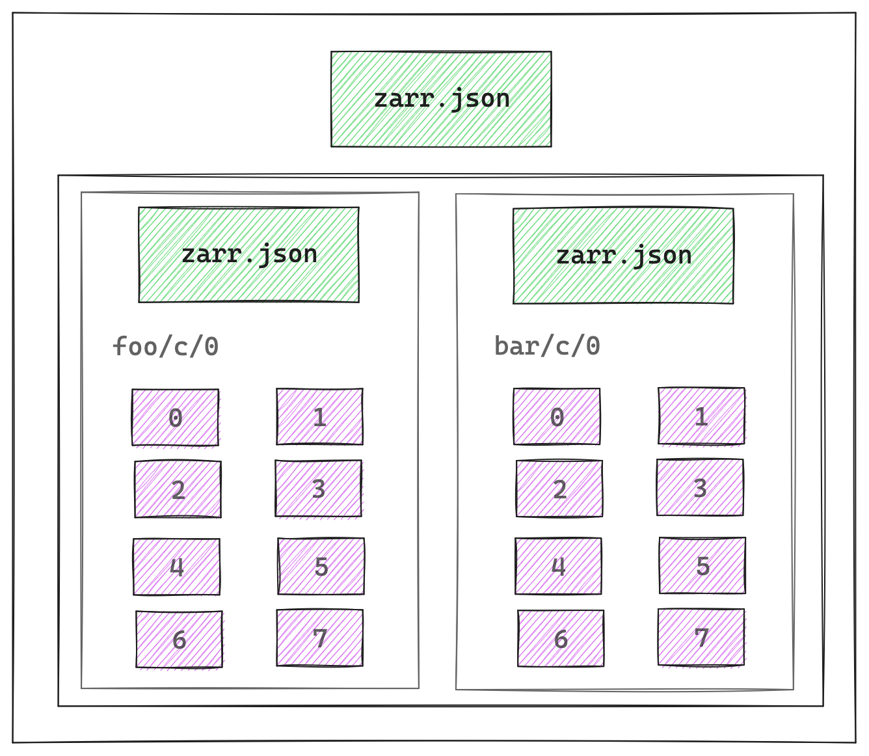
Zarr Groups → V2 vs. V3
V2
V3

Slide 24
Explicit support for features via defined extension mechanism

Slide 25
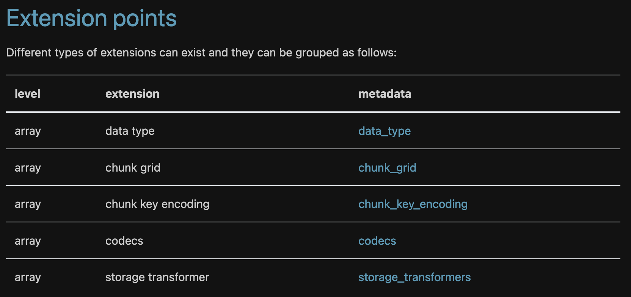

Slide 26
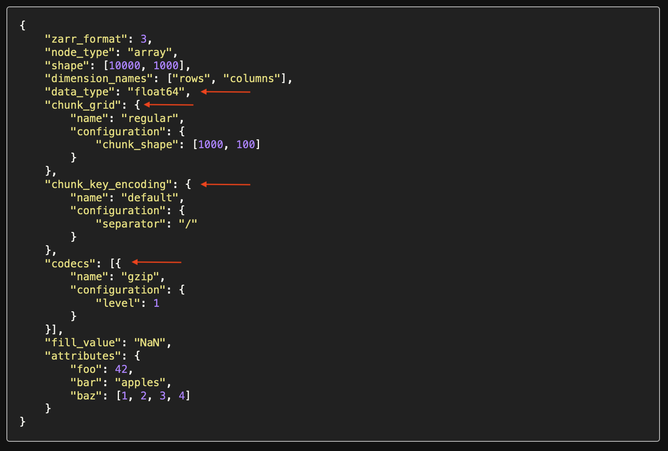
V3 Metadata

Slide 27
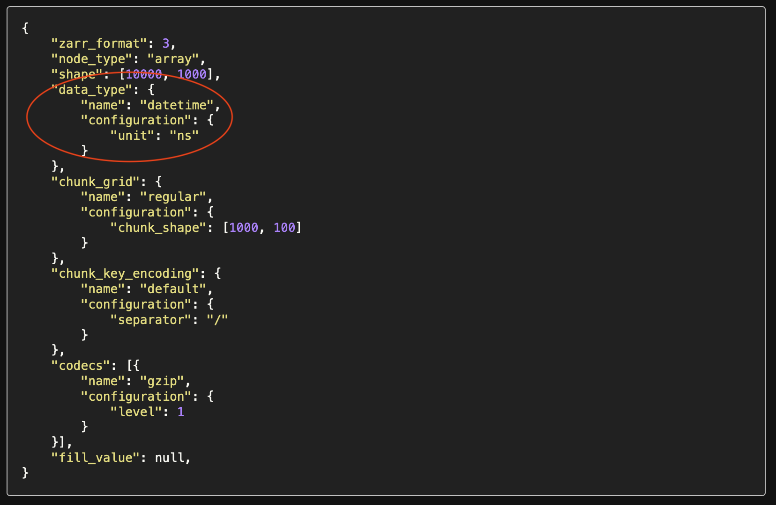
V3 Metadata w/ Extension points

Slide 28
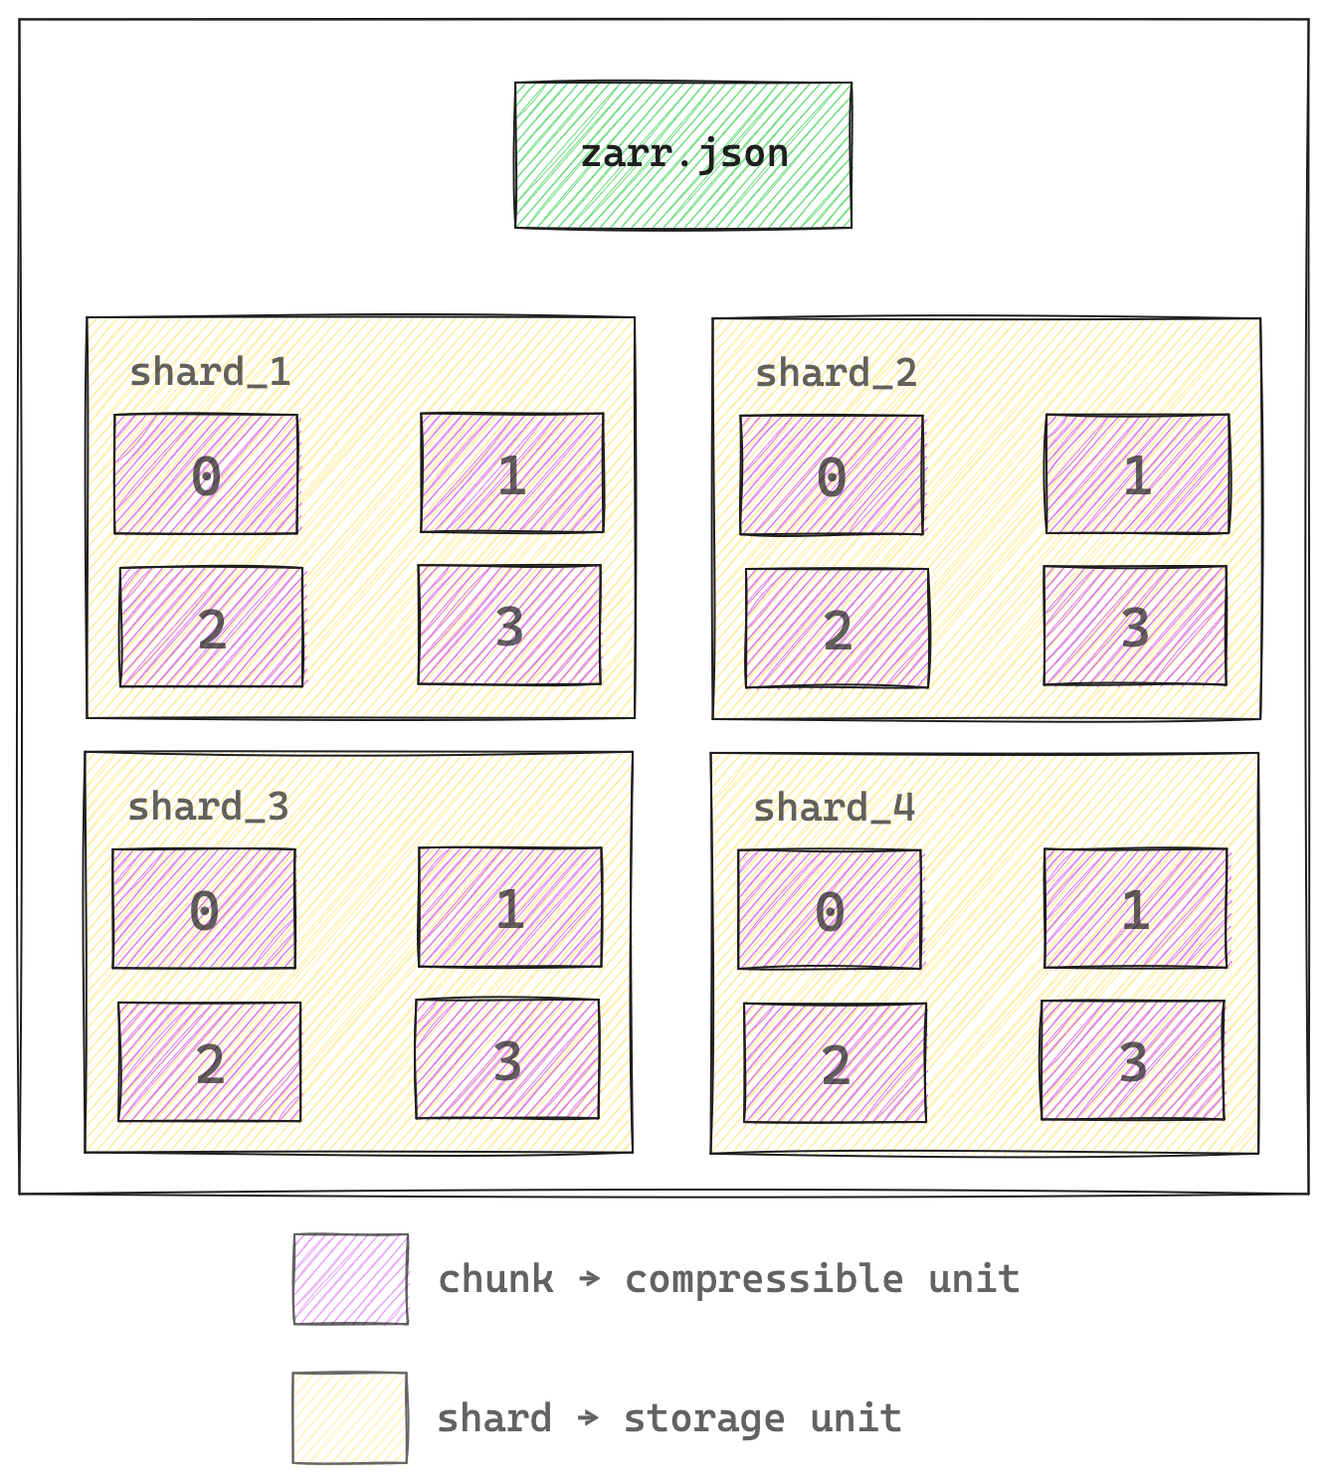

Sharding Codec
Via Extension Mechanism

Slide 29
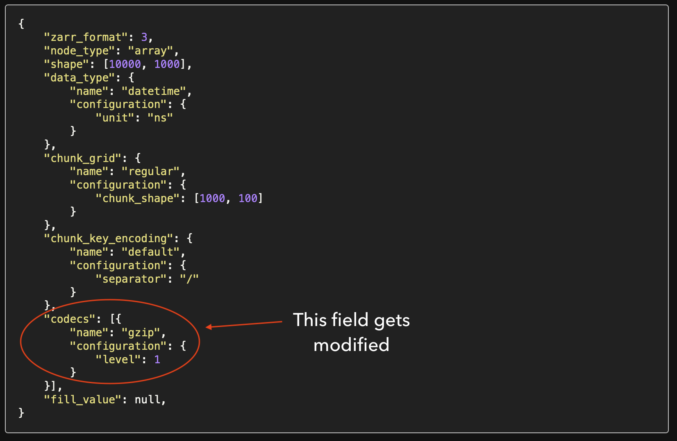
V3 Metadata w/ Sharding Codec

Slide 30
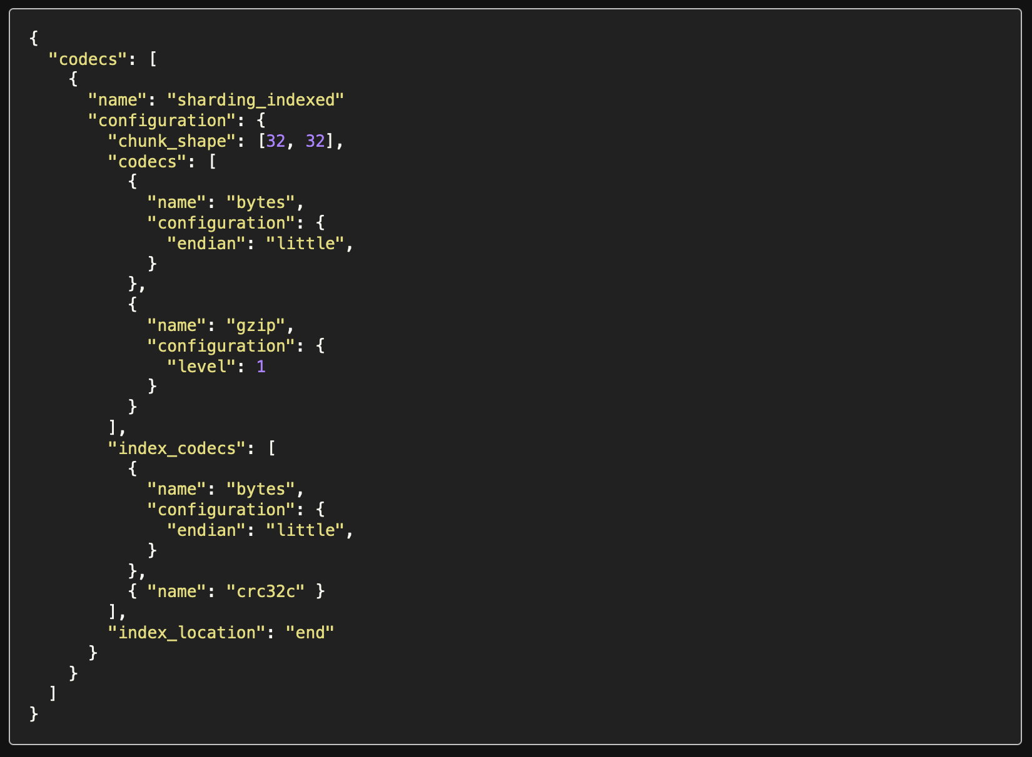
V3 Metadata w/ Sharding Codec

Slide 31
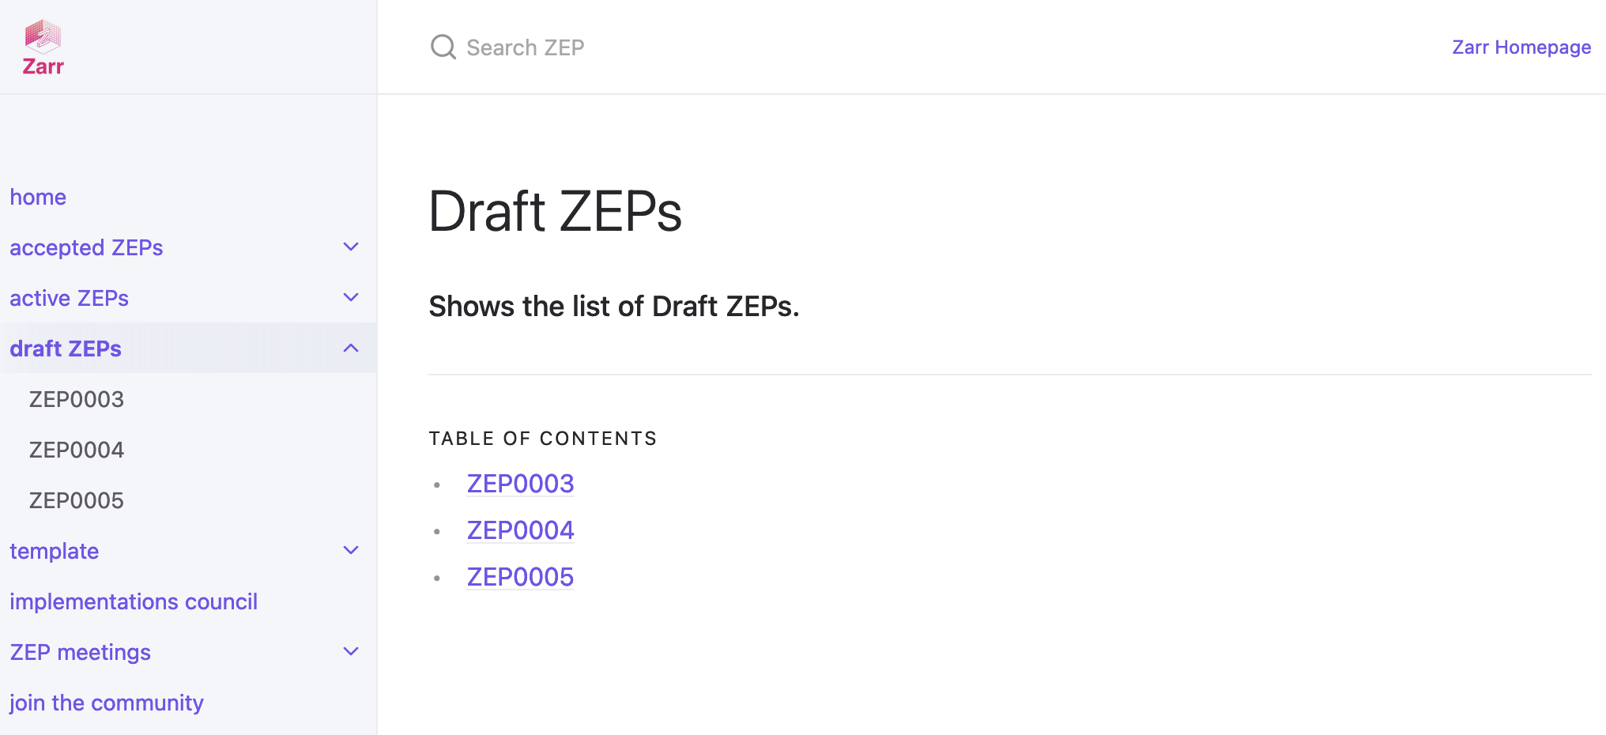
More extensions coming soon…
https://zarr.dev/zeps/draft_zeps/

Slide 32
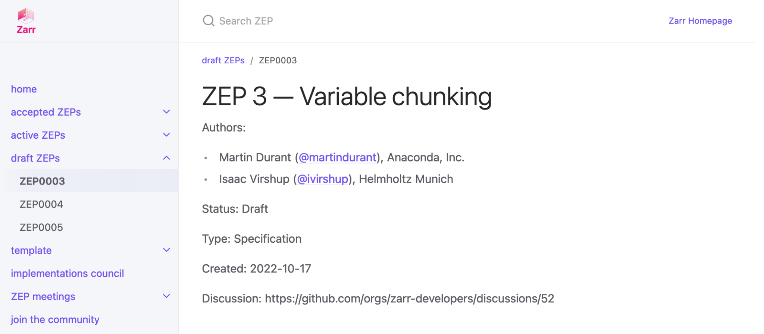
ZEP0003 - Variable Chunking
https://zarr.dev/zeps/draft/ZEP0003

Slide 33
Comparison with Zarr V2 Spec
→ dtype renamed to data_type
→ chunks replaced with chunk_grid
→ dimension_separator replaced with chunk_key_encoding
→ separator has changed from . to /
→ filters and compressor combined into codecs field

Slide 34
Zarr Community

Slide 35


Slide 36


Slide 37
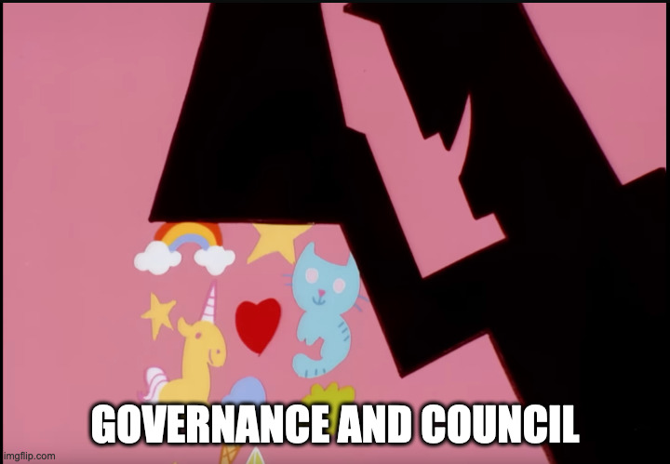

Slide 38


Slide 39
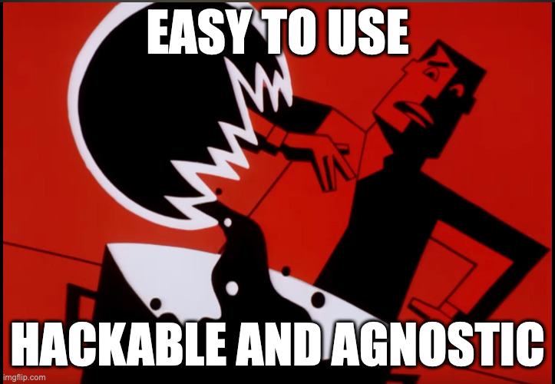

Slide 40


Slide 41


Slide 42


Slide 43
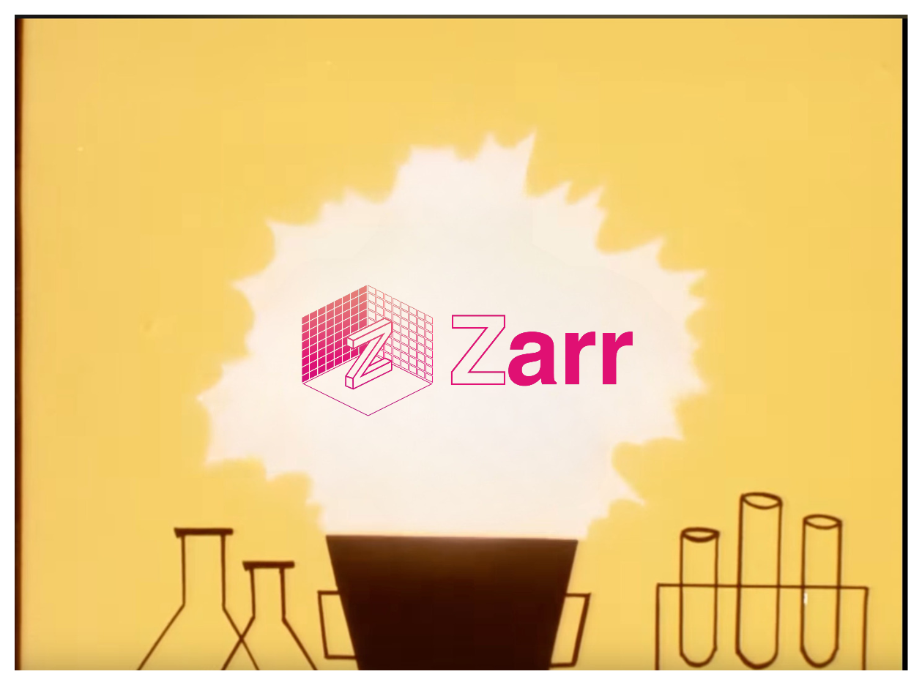

Slide 44
We have a large and diverse active community!
But…👀

Slide 45
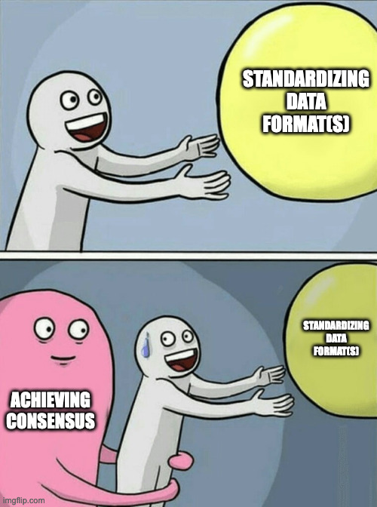


Slide 46
We needed a structured way to solicit and *process* the feedback!

Slide 47
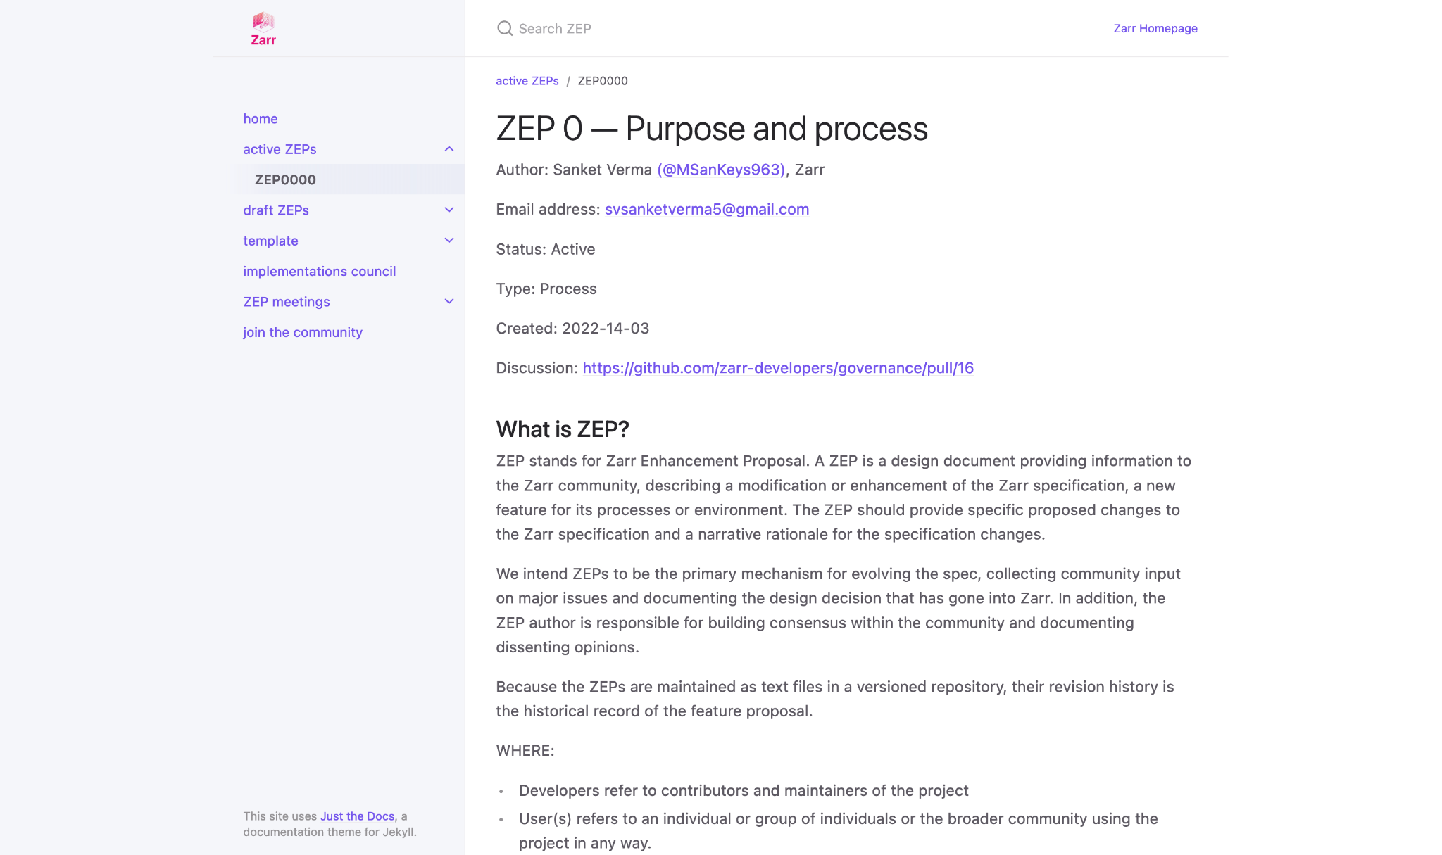
zarr.dev/zeps

Slide 48
How we did it? 🚶🏻‍♂️

Slide 49

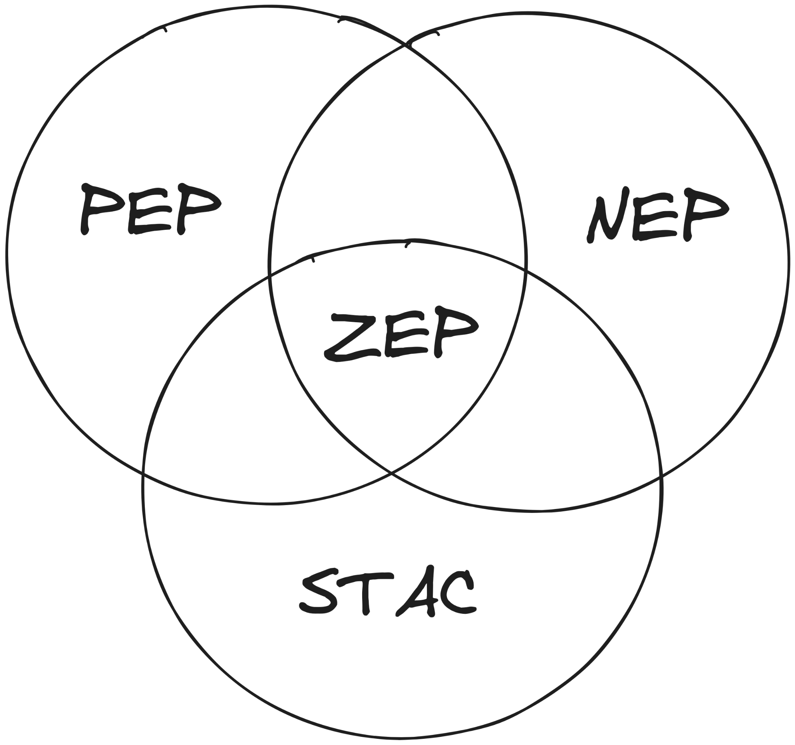

Lots of Reading
Previous Experience
Understanding the needs of the community

Slide 50

Braindump 🧠
ZEP Inception Blog post

Slide 51
How do we adopt a ZEP?

Slide 52


→

Slide 53
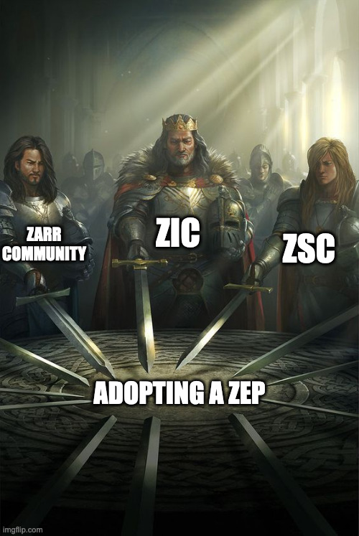

Slide 54
Demo

Slide 55

Creating and opening
(insert qr)
→ Zarr arrays and groups
→ Sharded arrays

Slide 56
How does V3 data looks like?

Slide 57



Citation:
Motta et al., Science 2019
Maintained by: /normanrz
(Norman Rzepka)
https://webknossos.org/links/NxMfC4B65CmTVGhr

Slide 58


/neuroglancer
https://github.com/google/neuroglancer
Maintained by: /jbms
(Jeremy Maitin-Shephard)
Neuroglancer visualiser

Slide 59
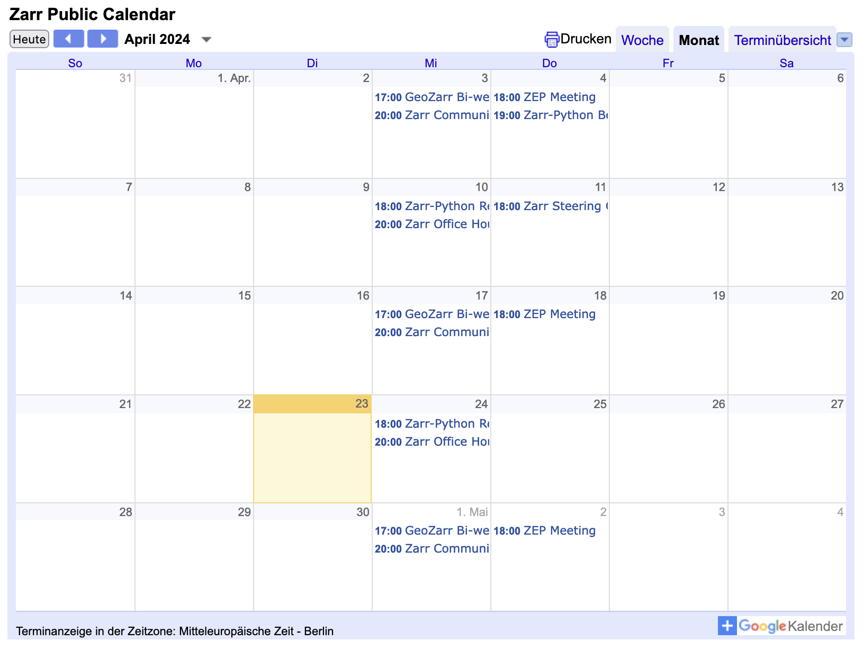
Join us at community, ZEP, core-dev meetings or office hours!
https://zarr.dev/community-calls/

Slide 60

Thank you! 🙏🏻
/zarr_dev

